Slide 1
Time Series: Unit 4

Slide 2
Discussion: Unit Circle

Slide 3
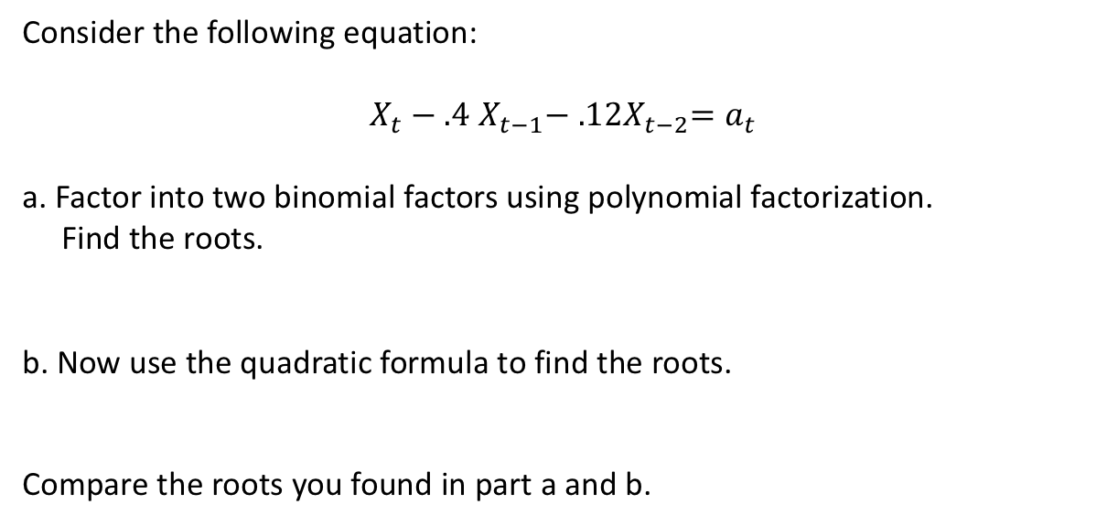
Break Out 1
Consider the following equation:
$X_{t}−.4$ $X_{t−1}−{ .12X}_{t−2}=a_{t}$
a. Factor into two binomial factors using polynomial factorization.
Find the roots.
b. Now use the quadratic formula to find the roots.
Compare the roots you found in part a and b.

Slide 4
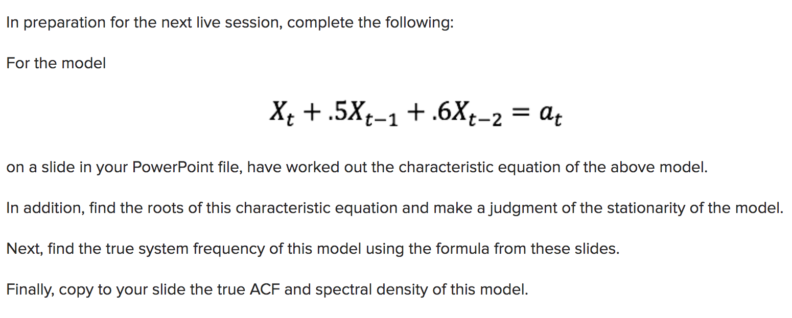
Break Out 2
Below were the instructions for the first pre live session assignment.
Please share your thoughts and / or questions on each part during this break out and we will discuss more once back in the main room!

Slide 5
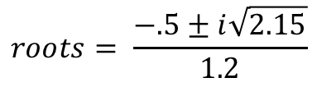
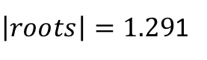
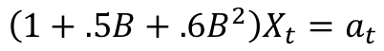
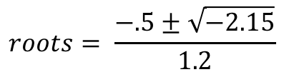
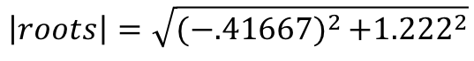
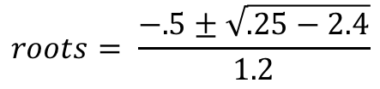
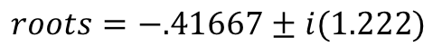
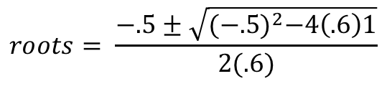
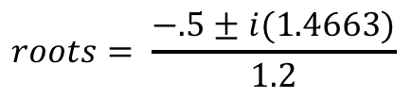
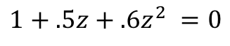
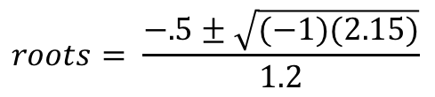
Break Out 2
$$roots= \frac{−.5±i(1.4663)}{1.2}$$
$$\left(1+.5B+.6B^{2}\right)X_{t}=a_{t}$$
$$roots= \frac{−.5±\sqrt{−2.15}}{1.2}$$
$$1+.5z+.6z^{2} =0$$
$$roots=−.41667±i(1.222)$$
$$roots= \frac{−.5±\sqrt{(−1)(2.15)}}{1.2}$$
$$\left|roots\right|=\sqrt{(−{.41667)}^{2}+{1.222}^{2}}$$
$$roots= \frac{−.5±\sqrt{{(−.5)}^{2}−4\left(.6\right)1}}{2(.6)}$$
$$roots= \frac{−.5±i\sqrt{2.15}}{1.2}$$
$\left|roots\right|=1.29$1
$$roots= \frac{−.5±\sqrt{.25−2.4}}{1.2}$$
The abs reciprocal (.7744) is less than 1 thus we know that the model is stationary.

Slide 6
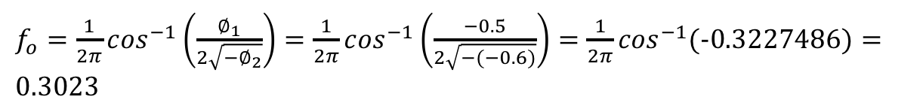
Break Out 2
$f_{o}=\frac{1}{2π}\cos^{−1}\left(\frac{∅_{1}}{2\sqrt{{−∅}_{2}}}\right)=\frac{1}{2π}\cos^{−1}\left(\frac{−0.5}{2\sqrt{−(−0.6)}}\right)=\frac{1}{2π}\cos^{−1}(−0.3227486)=0.3023$
(acos(-.5/(2*sqrt(.6))))/(2*pi)
The system frequency associated with this model is .3023

Slide 7
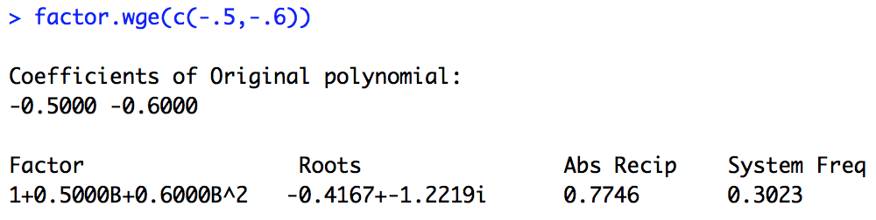
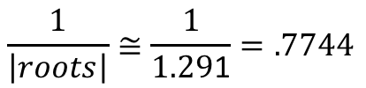
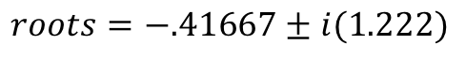
Break Out 2
$f_{o}=\frac{1}{2π}\cos^{−1}\left(\frac{∅_{1}}{2\sqrt{{−∅}_{2}}}\right)=\frac{1}{2π}\cos^{−1}\left(\frac{−0.5}{2\sqrt{−(−0.6)}}\right)=\frac{1}{2π}\cos^{−1}((−0.3227486)=0.3023$
$$roots=−.41667±i(1.222)$$
$$\frac{1}{\left|roots\right|}≅\frac{1}{1.29\text{1}}=.7744$$
The abs reciprocal (.7744) is less than 1 thus we know that the model is stationary.
The system frequency associated with this model is .3023

Slide 8
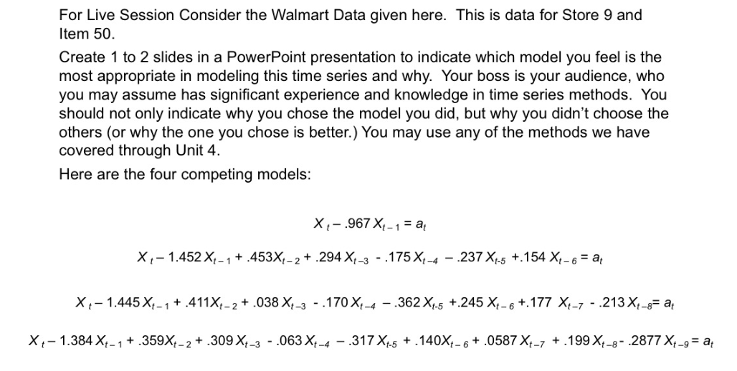
Break Out 3
Present your PowerPoint presentation to the members of your Break Out Group. Each presentation should be around 2-4 minutes. With any extra time, discuss your thoughts … keep in mind … all these models are wrong … which did you feel was most useful and why?

Slide 9
FLS Question
Why factor into 4th order polynomials or linear/quadratic factors?
We have studied and know very deeply what behaviors are associated with AR(1) and AR(2) models in terms of wandering, oscillating, frequencies, etc. Since any order polynomial can be written as a product of deg 1 and 2 polynomials and thus and AR(p) model can be written as AR(1)s and AR(2)s we can find out a lot of the qualities of complex models by looking at how they are composed ... at their DNA.

Slide 10
Break Out 3
Store9Item50 = Walmart %>% filter(store == 9, item == 50)
plotts.sample.wge(Store9Item50$sales)
System frequencies at approximately 0, .15, .29, .43.

Slide 11
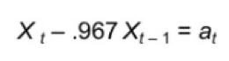
Break Out 3
plotts.true.wge(n = 100,phi = .967)

Slide 12
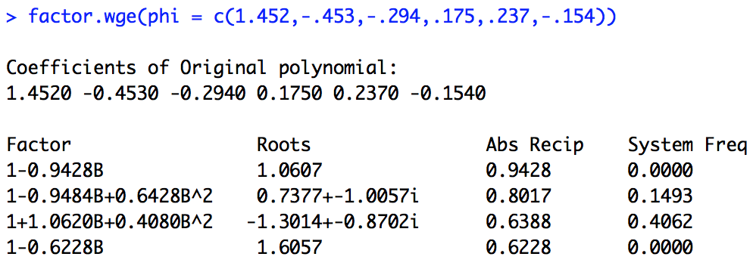
Break Out 3
plotts.true.wge(phi = c(1.452,-.453,-.294,.175,.237,-.154))

Slide 13
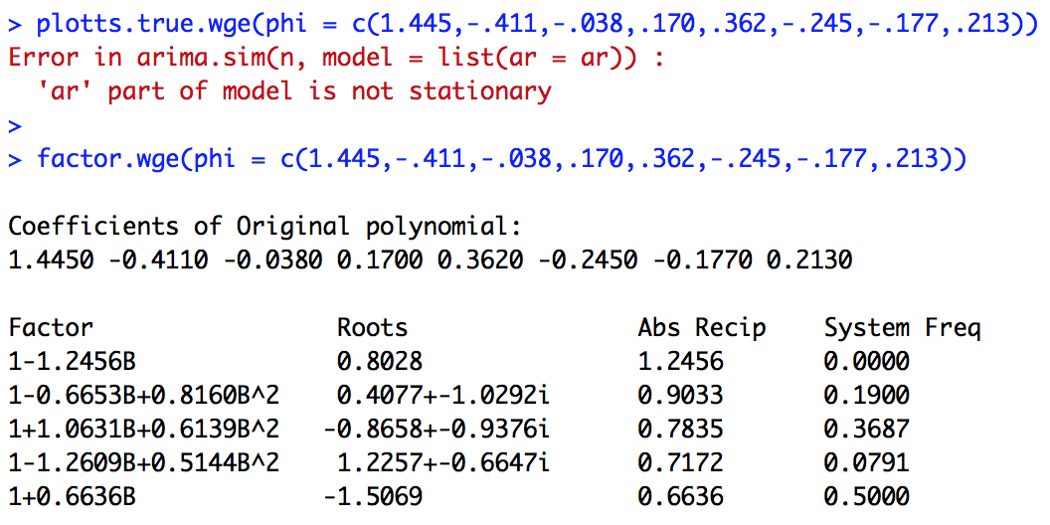
Break Out 3
plotts.true.wge(phi = c(1.445,-.411,-.038,.170,.362,-.245,-.177,.213))

Slide 14
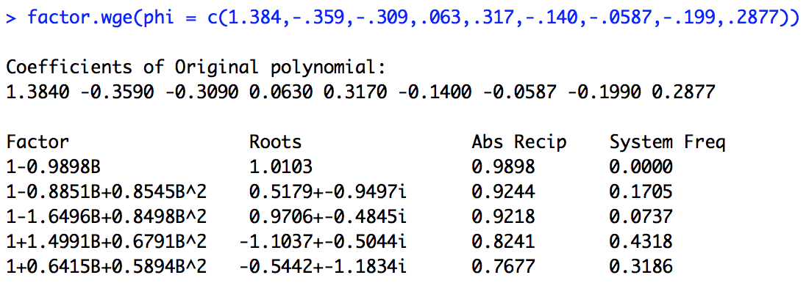
Break Out 3
plotts.true.wge(phi = c(1.384,-.359,-.309,.063,.317,-.140,-.0587,-.199,.2877))
I went with the AR(9) model above since the .15 and .43 frequencies were represented and the ACFs were at least somewhat sinusoidal and slowly damping. However, the strong frequency at .0737 is a clear mark against this model. None of the models look to be particularly satisfying. However, we will develop more models that will help us with this data.

Slide 15
Break Out 3
Here are three more models to investigate. Do you like any of these better? If so, are there still some shortcomings?
$${a. X}_{t}−.1516X_{t−1}−{.0769X}_{t−2}−.0016X_{t−3}+.0095X_{t−4}−.0542X_{t−5}−.1117X_{t−6}−.5683X_{t−7}=a_{t}$$
This might help:
c(0.1516, 0.0769, 0.0016, -0.0095, 0.0542, 0.1117, 0.5683)
$${b. X}_{t}−.4295X_{t−1}−{.1769X}_{t−2}−.0358−.1454X_{t−4}=a_{t}$$
This might help:
c(.4295, .1769, .0358, .1454)
$$c. X_{t}−.1529X_{t−1}−{.0988X}_{t−2}−.0059X_{t−3}+.0075X_{t−4}−.0538X_{t−5}−.1118X_{t−6}−.5717X_{t−7}−.0034X_{t−8}−.0382X_{t−9}=a_{t}$$
This might help:
c(0.1529, 0.0988, 0.0059, -0.0075, 0.0538, 0.1118, 0.5717, 0.0034, 0.0382 )
plotts.true.wge(phi = c(0.1516, 0.0769, 0.0016, -0.0095, 0.0542, 0.1117, 0.5683))
plotts.true.wge(phi = c(0.4295, 0.1769, 0.0358, 0.1454))
plotts.true.wge(phi = c(0.1529, 0.0988, 0.0059, -0.0075, 0.0538, 0.1118, 0.5717, 0.0034, -0.0382 ))

Slide 16
Break Out 3
Here are three more models to investigate. Do you like any of these better?
$${a. X}_{t}−.1516X_{t−1}−{.0769X}_{t−2}−.0016X_{t−3}+.0095X_{t−4}−.0542X_{t−5}−.1117X_{t−6}−.5683X_{t−7}=a_{t}$$
plotts.sample.wge(Store9Item50$sales)
plotts.true.wge(phi = c(0.1516, 0.0769, 0.0016, -0.0095, 0.0542, 0.1117, 0.5683))
plotts.true.wge(phi = c(0.1516, 0.0769, 0.0016, -0.0095, 0.0542, 0.1117, 0.5683))
plotts.true.wge(phi = c(0.4295, 0.1769, 0.0358, 0.1454))
plotts.true.wge(phi = c(0.1529, 0.0988, 0.0059, -0.0075, 0.0538, 0.1118, 0.5717, 0.0034, -0.0382 ))

Slide 17
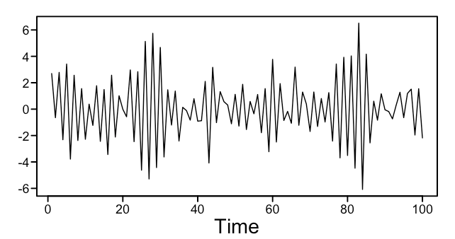
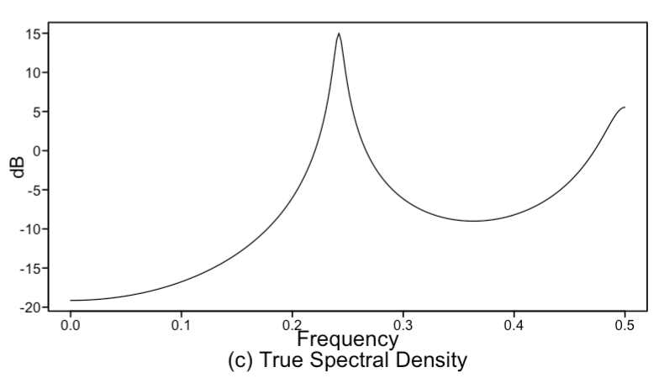
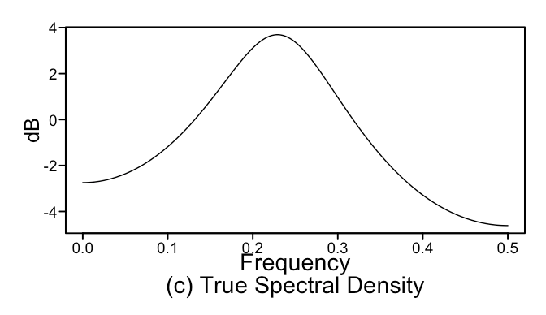
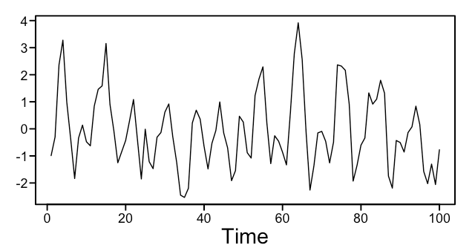
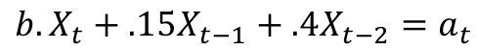
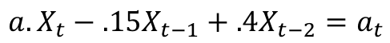
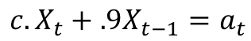
Break Out 4
Match the model on the left to the appropriate plot(s) on the right!
1.
$${a. X}_{t}−.15X_{t−1}+.4X_{t−2}=a_{t}$$
$${b. X}_{t}+.15X_{t−1}+.4X_{t−2}=a_{t}$$
2.
$${c. X}_{t}+.9X_{t−1}=a_{t}$$
3.
$${d. X}_{t}−.8X_{t−1}−{.86X}_{t−2}−.855X_{t−3}=a_{t}$$
4.

Slide 18
Break Out 4
Match the model on the left to the appropriate plot(s) on the right!
3.
$${a. X}_{t}−.15X_{t−1}+.4X_{t−2}=a_{t}$$
$${b. X}_{t}+.15X_{t−1}+.4X_{t−2}=a_{t}$$
4.
$${c. X}_{t}+.9X_{t−1}=a_{t}$$
1.
$${d. X}_{t}−.8X_{t−1}−{.86X}_{t−2}−.855X_{t−3}=a_{t}$$
2.

